Slide 1
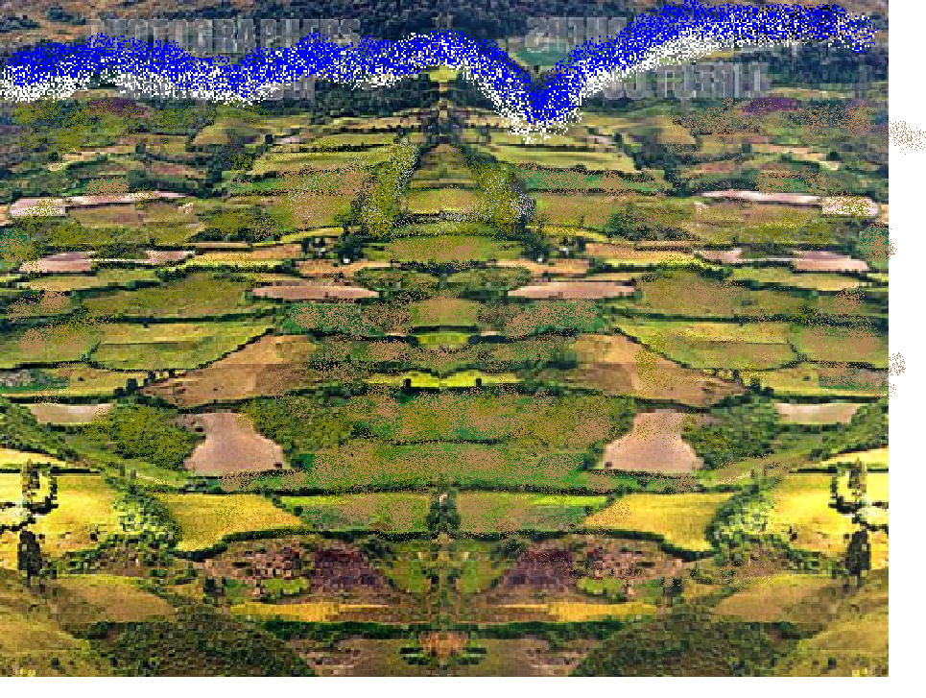
The Past, Present and Future of Canal Irrigation in India
Tushaar Shah
Senior Fellow,
International Water Management Institute, Colombo

Slide 2
Indian agrarian land scape circa 1800. A great deal of adaptive small-scale community irrigation. But irrigation-surface and ground-- used only 5-10% of blue water resources and rivers were pretty much left alone.

Slide 3
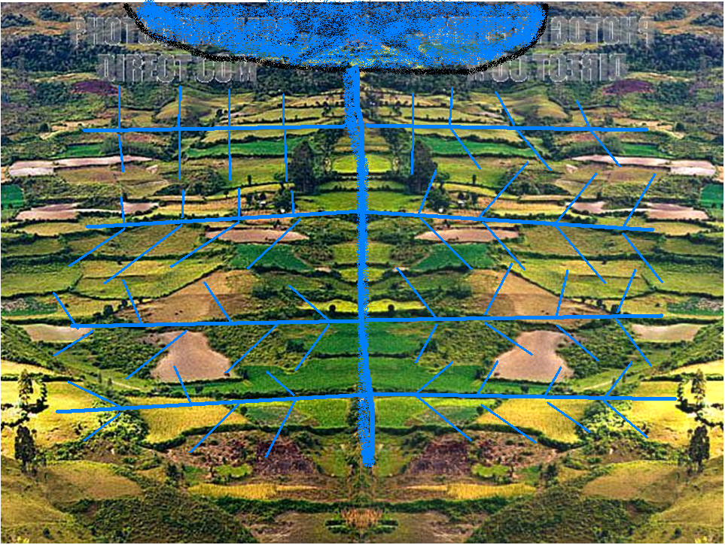
East India Company saw in canal irrigation a business opportunity.. To combine ‘interests of commerce with charity’.

Slide 4
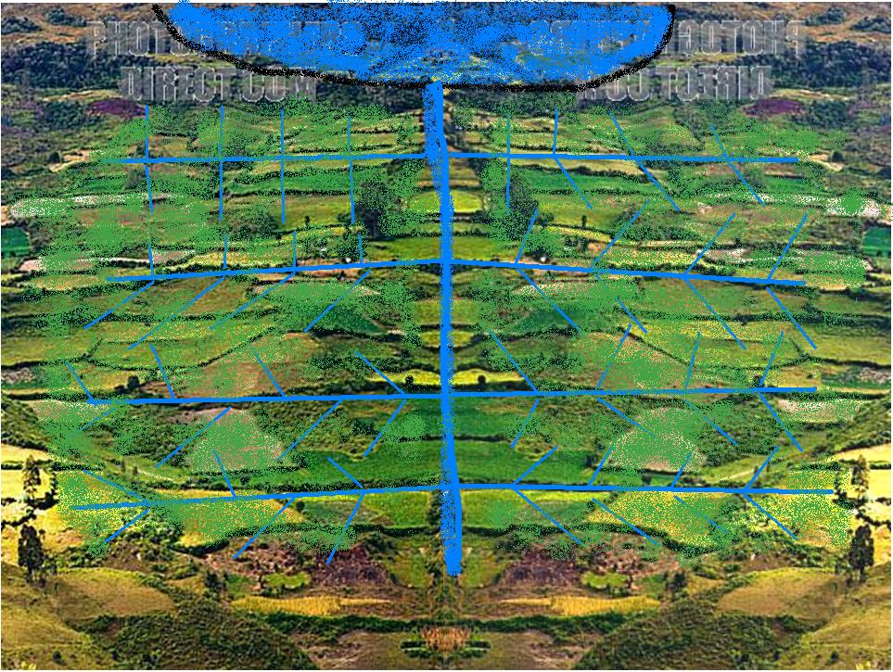
Extensive/protective irrigation of dry crops over large areas
In IGB, most wells fell into disuse; many were filled up.

Slide 5
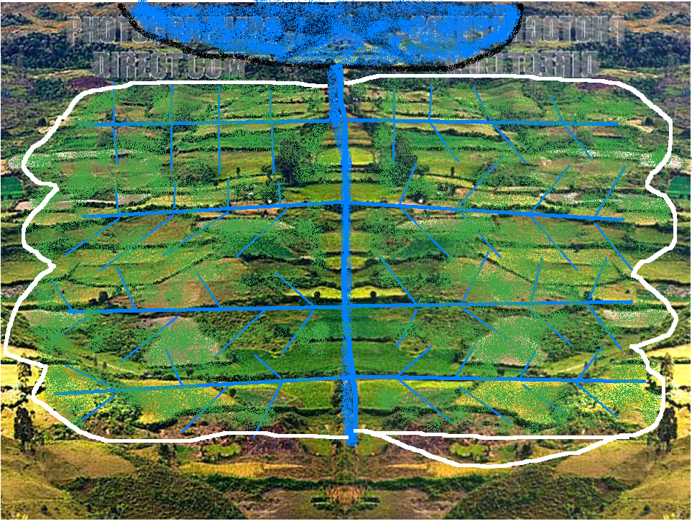
Regular maintenance
Rule Enforcement
Effective and efficient Main System Management

Slide 6
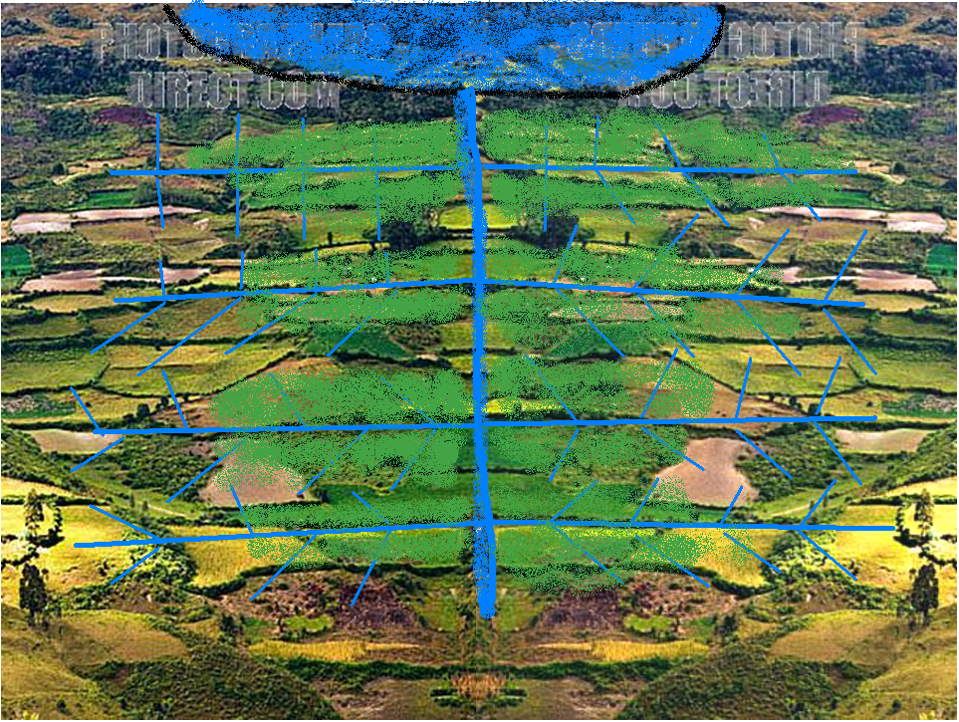
All these three preconditions are violated in Indian systems today
Anarchy; deferred maintenance; poor main-system management

Slide 7
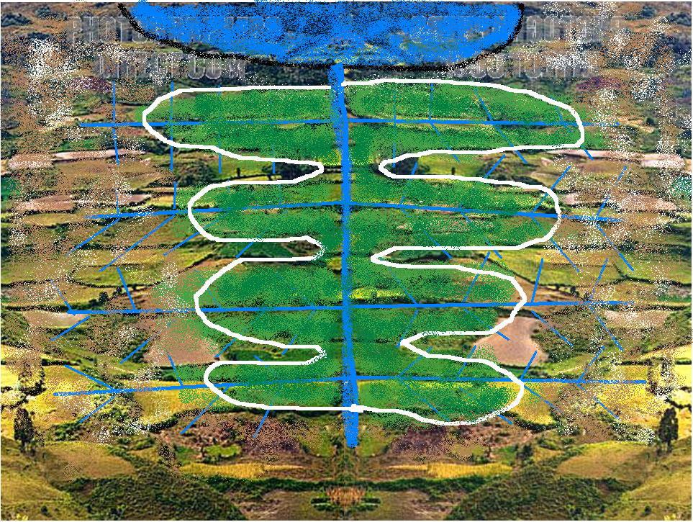
And wells returned with a vengeance now with motor pumps to replace muscle power.

Slide 8
Rice, sugarcane, banana
Instead of canal water, farmers agitated for power subsidies.
GW boom muted the failure of public irrigation.

Slide 10
 |  | Data for year | Major & Medium Schemes | Groundwater | Other sources
1 | Minor Irrigation Census, October 2005, Net area irrigated | 2000-1 | 10.23 m Ha | 30.5 m Ha | 5.71 m Ha
2 | NSSO 59th Round: | Jan-Dec 2003
2a | % of net area sown in kharif irrigated by: |  | 7.75% | 28.95% | 5.55%
 | Estimated kharif area irrigated by: |  | 8.37 m Ha | 31.3 m Ha | 5.99 m Ha
2b | % of net area sown in rabi irrigated by: |  | 7.68% | 42.86% | 5.79
 | Estimated rabi area irrigated by: |  | 7.83 m Ha | 43.7 m Ha | 5.91 m Ha
 | Estimated gross area irrigated by: |  | 16.2 m Ha | 75 m Ha | 11.9 m Ha
3 | Ministry of Agriculture, Govt. of India: Net area irrigated by: | 2001-2 | 15.9 mHa | 35.04 m Ha | 7.59 m Ha
4 | Central Water Commission/ICID | 2003-4 | 31.3 m Ha
Irrigation establishment’s estimate of canal irrigation

Slide 11
1.1 Local authority structures 1.2 State interest in irrigation 1.3 Forced Labor
2.1 Property rights in land 2.2 Irrigated cropping pattern 2.3 Incentives in farming 2.4 Ease of exit from farming 2.5 Agrarian institutions
3.1 Population pressure on land
4.1 The cost and effort needed for water lifting and transport
Unit of irrigation organization
Pre-Colonial (Adaptive Irrigation)
Strong Revenue Rampant
No pvt property Rice; uniform High land taxes; Poor market links Low feudal
Very low; extensive land use
Very High
Irrigation Community
Colonial (Constructive Imperialism)
Strong Revenue Widespread
No pvt property Rice; uniform High land taxes; Poor mkt links Low feudal
Very low; extensive land use
Very high
+ Centralized irrigation system
Post-Colonial (Atomistic Irrigation)
Weak Welfare Impossible
Pvt land rights; Diverse; No taxes; Mkt access; High egalitarian
Very high; intensification and diversificatio
Low
Individual farmer
Canal system= IBM Mainframe
Tubewell= IBM PC
Diesel Pump= Lap top

Slide 12
For exploiting peasantry through rack-renting, the Colonial administration maintained systems, enforced rules and managed main-systems efficiently. The welfare state failed to do any of these.
The British earned 11% return on irrigation investments right up to 1945. By 1955, India was subsidizing canal irrigation.
In 1938, water fee was the largest source of Punjab government income. In 1960, Bihar abolished water fee because collection cost was higher than the fee.

Slide 13
Can PIM/IMT fix irrigation?
No incentive for PIM here; winner-take-all
Farmers here are worse off but they too prosper by depleting aquifers using free power.
No incentive for PIM here either. What do they manage?

Slide 14
Shrinking of Canal Commands
 | Canals | Groundwater
Storage | 213 BCM | 413
Diversion | 90 BCM | -
Total water circulating | 300 BCM | 230 BCM
Net Area irrigated | 16 m ha | 50-60 m ha
Storage/ha of net irrigated area | 19000 m³ | 4200 m³
Canal areas apply 4 times more water than groundwater
A good deal evaporates
Spreading surface storages thinly over much larger areas is the best option for conjunctive management

Slide 15
Future of Indian Irrigation:
Scenario I
Business-as-Usual
Low-level Equilibrium

Slide 16
Future of Indian Irrigation:
Scenario II
Rehabilitation and Modernization, PIM/IMT
Build-Neglect-Rebuild
Rehabilitation & Modernization Projects try to do this.
However, these overlook the changing socio-technical context.
Blind to the built-in-failure;
Blind also to new opportunities.. South Asian canal commands are unlike any in the world.

Slide 17
Future of Indian Irrigation:
Scenario III
Fuse Formal with Informal

Slide 18
# | System modification and adaptation | Examples | How widespread is this in India?
1 | Classical Canal Irrigation: The System operates as designed; wells are driven out by gravity flow irrigation. | ? Mahi command in early 1970’s; Bhakra command in the 1950’s | Not at all
2 | Main system delivers water in farm ponds (diggi’s) fortnightly | Indira Gandhi canal, Rajasthan | Not very
3 | Main system delivers water in village ponds as intermediate storages; farmers irrigate by gravity or lift | Sardar Sarovar; System tanks in South India | Some
4 | Main system delivers water into canals; farmers/groups lift and irrigate | Mahi system; Upper Krishna, Sardar Sarovar command | Very widespread throughout India
5 | Main system delivers water to a village contractor on volumetric basis and he allocates water to farmers and collects water fees | Several systems in China | This model is spreading in China
5 | Main system recharges the aquifers in the command; much irrigation surplus results from tubewell irrigation | Bhakra; Mahi; Upper Krishna basin | Very very widespread
6 | Irrigation tanks support well irrigation in their command | Tamilnadu; AP, Karnataka, Eastern Rajasthan | Very, very widespread
7 | Irrigation tanks converted into percolation tanks | Tamilnadu; Rayalaseema in Andhra Pradesh | Not very, but gaining

Slide 19
For leapfrogging Indian public irrigation, what is needed is:
Redefine the role of irrigation deptt.
Capacity building in irrigation bureaucracies
Culture change; performance orientation; incentives and authority
Improved main-system management;
Public private partnership in water distribution
To maximize areas under conjunctive use.
Thank you.

